Slide 1


IT2775 Operations Security
Security Configuration Management

Slide 2
Objectives
What is SCM?
SCM Phases
  Planning
  Configuring to a Secure State
  Maintaining Secure State
  Monitoring

Slide 3
Security Configuration Management
What is SCM ?
  design, planning, implementation and review of security configurations of computer resources.
  manage the security risks of information assets.
  apply CM to security assets in the organization.
Elements of SCM:
  Management of security configuration baselines for workstations, servers, routers, firewalls.
  Continuous and proactive assessment to prevent configuration drift and ensure policy compliance.
  Adherence to industry standards.

Slide 4
Security Configuration Management
Typical CUs in SCM includes:
  Computing endpoints (workstations/laptops)
    Accounts, ACLs installed in the machine
    Anti-virus installation, including configuration items in the AV engine
  Network Devices
    Accounts for administration
    ACLs for network protocols
  Servers
    Administration accounts
    Services and Applications
    Users’ accounts

Slide 5
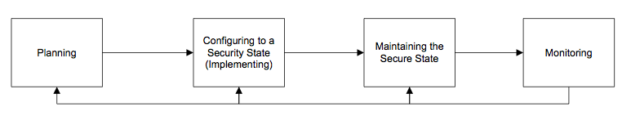
SCM Phases
Planning
Configuring to a Secure State
Maintaining Secure State
Monitoring

Slide 6
1. Planning
Establish organization-wide SCM program
  Effective if implemented consistently in organization.
  Requires senior management commitment.
  Advantageous to leverage on existing CM program.
Develop organisation-wide SCM policies
  Purpose
  Scope
  Roles & Responsibilities
  Activities
  Monitoring
  Standards
  Training requirements
  SCM templates
  Automated tools
  Prohibited configuration
  Inventory requirements of security assets

Slide 7
2. Configuring to a Secure State
Establish secure configurations
  Secure configurations applied to CUs
    OS features, services, ports, protocols, remote access.
    Patch levels, software version, signed software
    Endpoint protection: antivirus, personal firewalls.
    Transport Protocol Protections (e.g., TLS, IPSEC).
    System Architecture – where component physically and logically resides
    Documentation – supporting documents may include technical specification.
  Reference organizational policies and standards such as NIST checklists.

Slide 8
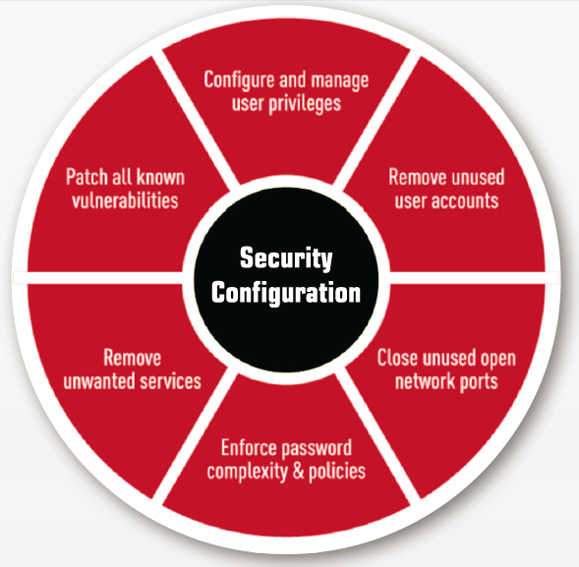
2. Configuring to a Secure State
Implement secure configuration
  May require a particular series of steps or deviate to insecure state in order to implement some features.
  Approach:
    Prioritize configuration
      Essential items first
    Test configurations
      Compatibility issues
      Use test setup.
    Resolve issues
      Analyse impact to other CUs
    Document baselines:
      Approval, automated tools.

Slide 9
3. Maintaining Secure State
Changes must be managed and controlled.
  Restrict modify rights
    ACLs to restrict who can make what changes.
  Change control process
    Only requested, analyzed and tested changes allowed.
  Security impact analysis
    Analyse change, identify vulnerabilities, assess risks and impact. Plan safeguards and countermeasures.
  Document and archive
    Technical designs, baseline configurations, security plans and risk assessments.
    Archive previous versions for traceability during audits.

Slide 10
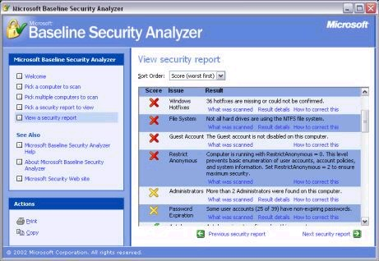
4. Monitoring
Ensure actual state is as expected.
  Most threats come from unregistered components.
  Activities:
    Scan to discover unregistered components.
    Scan to identify disparities between actual vs. baselined configuration.
    Run automated monitoring tools.
    Run system integrity checks to detect changes.

Slide 11
Summary
What is SCM?
SCM Phases
  Planning
  Configuring to a Secure State
  Maintaining Secure State
  Monitoring

Slide 12
Change Management vs. CM vs. SCM
Shapes
Change Management
Any type of changes
Win7 to Win8, GST, Data Privacy Law
Object Oriented Analogy
Quadrilaterals
Configuration Management
H/w or S/w configuration changes
BIOS, Printer, OS, DB, Web settings
Trapezium
Security Configuration Management
Security configuration changes
Firewall, IDS, AV, OS, DB, Web security settings

